Slide 1
Business Data Analytics With AI
Name
Department Course Number Section Time Location
DATE

Slide 2
Name
Department Course Number Section Time Location
DATE
Introduction
Class
Contact
Agenda

Slide 3

About Me
Name
Department Course Number Section Time Location
DATE
Luman Awale
Title/Position:
Software Engineer at Zaki point Health
Module Teacher :
Business Data Analytics With AI

Slide 4

About Students
Name
Department Course Number Section Time Location
DATE

Slide 5
Learning Outcome
Name
Department Course Number Section Time Location
DATE
Outline
replace intuition-based decision-making with data-driven insights
optimizing operations and profitability
bridging the gap between technical data analysis and executive

Slide 6


Class Methods
Name
Department Course Number Section Time Location
DATE

Slide 7
Class Expectations
Name
Department Course Number Section Time Location
DATE
Do’s
Don’ts
Focus
Consistent
Implementation
Disruptions
Cognitive Focus

Slide 8
Schedule
Name
Department Course Number Section Time Location
DATE
Day: Monday to Friday
Holiday: Saturday and Sunday
Time: 7a.m to 9a.m

Slide 9
Behavior
and Manners
Name
Department Course Number Section Time Location
DATE
maintaining focus, showing mutual respect, and minimizing disruptions to foster a collaborative learning environment
Communication and participation
Respecting space and property
Group work and peer interaction.
Raise your hands
Speak Politely
Do not interrupt
Tips

Slide 10
Class Materials
Name
Department Course Number Section Time Location
DATE
Laptops
Note Books
Tools

Slide 11
Contact Me
Name
Department Course Number Section Time Location
DATE
Email
Incase of any help related to class or topic you didn’t understand feel free to contact me at given email or number
Teams
Luman Awale

Slide 12


MODULE 1

Slide 13






Today’s Agenda
Data Analytics vs Business Analytics
Analytics in Real-World Business
The Data Lifecycle
Career Paths in Analytics and Data
Excel for Data Analytics
Basic Statistics in Fundamentals

Slide 14
Key Differences between Data Analytics and Business Analytics
Aspect | Data Analytics | Business Analytics
Primary Question | "What does the data tell us?" | "How can we improve the business?"
Skills Emphasis | Programming, statistics, machine learning | Domain knowledge, communication, strategy
Tools | Python, R, SQL, Tableau | Excel, Power BI, Dashboards
Output | Insights, models, visualizations | Reports, recommendations, decisions
Stakeholders | Data teams, engineers | Executives, managers, clients

Slide 15







Finance
Marketing
Risk Analysis, Fraud Detection, portfolio analysis
ROI Analysis, A/B Testing, customer journey mapping
Retail
Health Care
Inventory Optimization, Decision Making, Recommendation, Customer base analysis
Diagnosis Analysis, optimized patient outcome, reduce operational cost
E-Commerce
Cart abandonment analysis, price optimization, user behaviour analysis

Slide 16



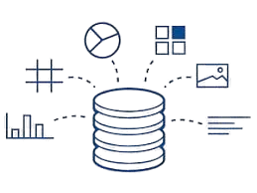

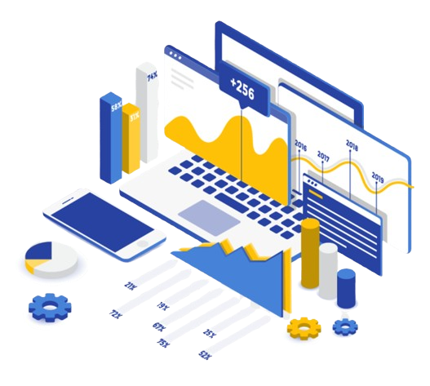
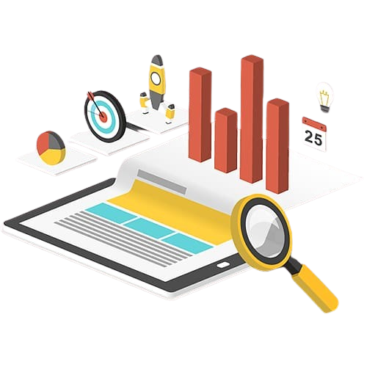


Data Collection
(Raw Data)
Cleaning
Analysis
Visualization
Decision Making
- Primary Source of data like Surveys and experiments
- Secondary Sources like databases and API’s
- Maintaining of the quality of data
- 80% of time of analysis and data preparation
- Handling missing Values
- Remove duplicates and inconsistencies
- Foundation of analysis
- Standardized formats
- 27% of data contains critical errors
- 4 times faster decision making
- Descriptive (What happened)
- Diagnostic (Why)
- Predictive (What will happen)
- Prescriptive(What to do)
- Finding patterns by stats and trends
- Faster ways to understand, visual representation in charts, dashboard of reports.
- Transforming stats into stories and charts with right messages.
- Diagrams speaks more
- Insights transformed into business strategies and actions.
- Boost business outcomes
- Productivity boost using analytics

Slide 17
Data Collection (Raw Data)
Primary Source of data like Surveys and experiments
Secondary Sources like databases and API’s
Maintaining of the quality of data
80% of time of analysis and data preparation

Slide 18
Cleaning
Handling missing Values
Remove duplicates and inconsistencies
Foundation of analysis
Standardized formats
27% of data contains critical errors

Slide 19
Analysis
4 times faster decision making
Descriptive (What happened)
Diagnostic (Why)
Predictive (What will happen)
Prescriptive(What to do)
Finding patterns by stats and trends

Slide 20
Visualization
Faster ways to understand, visual representation in charts, dashboard of reports.
Transforming stats into stories and charts with right messages
.
Diagrams speaks more

Slide 21
Decision Making
Insights transformed into business strategies and actions.
Boost business outcomes
Productivity boost using analytics

Slide 22
Any
Questions?

Slide 23

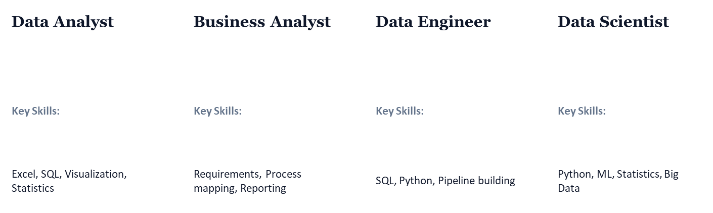
Multiple pathways to a rewarding career in data
Note: There are other job options, including market analyst, product analyst, SQL developer, and data architect.

Slide 24
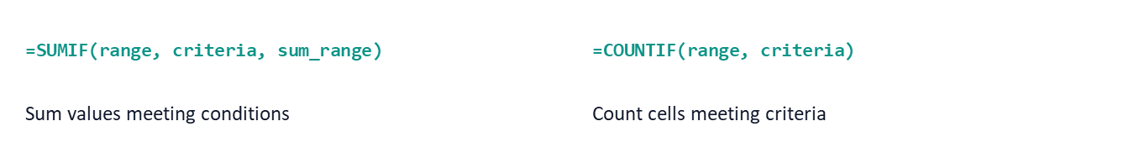
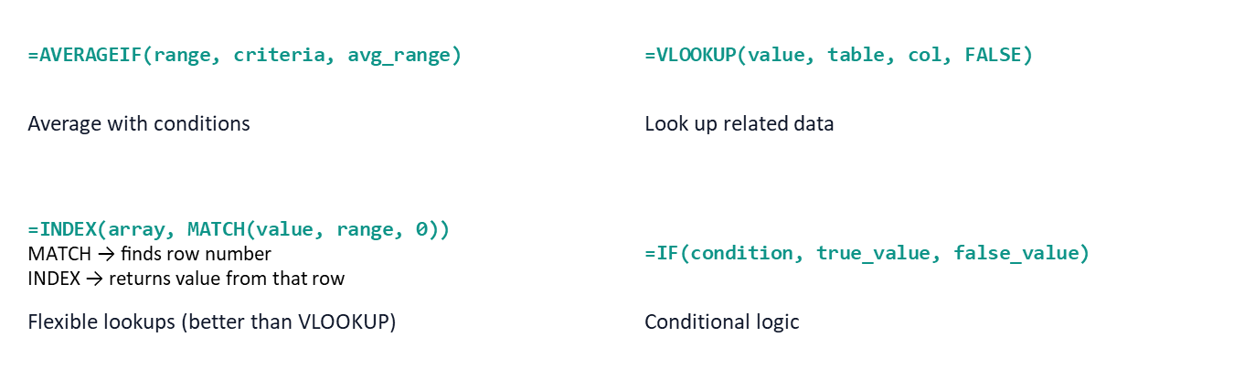

Slide 25
Lets See it in Excel

Slide 26

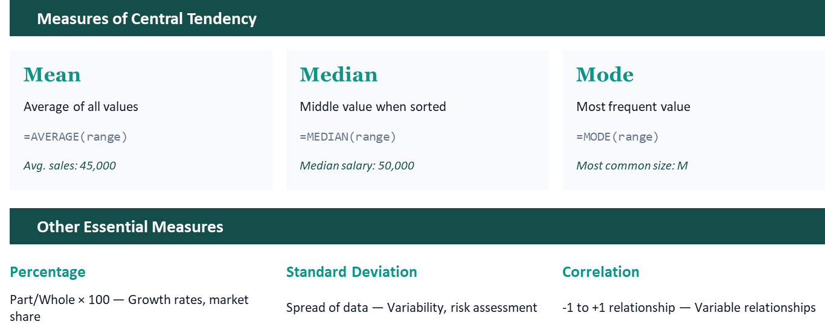

Slide 27
Any
Questions?

Slide 28
Module - 2
Day - 2

Slide 29
Data Cleaning and ETL
Data Sourcing
ETL
Identifying Missing Values and Fixing missing values, duplicates, and inconsistent data
Data Quality checks

